Slide 1
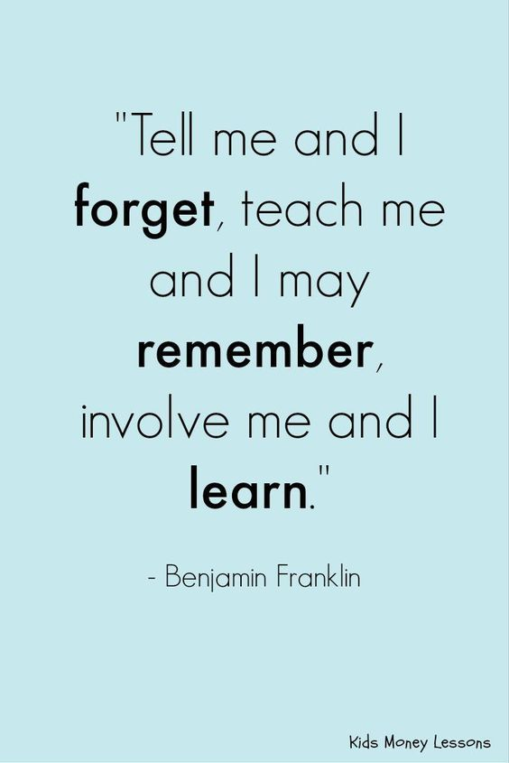
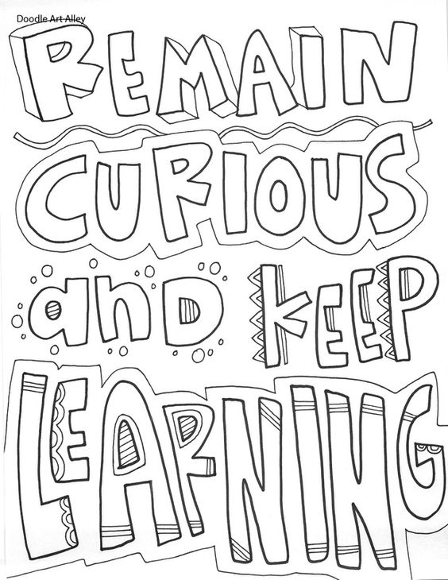
Revision - Top Tips
“I’M STILL LEARNING.” –MICHELANGELO
MAKE GOOD USE OF YOUR KNOWLEDGE ORGANISERS…
Short bursts of revision (30‑40 minutes) are most effective. Your concentration lapses after about an hour and you need to take a short break (5‑10 minutes).
Plan a timetable of revision .
Mix up the topics and subjects don’t stay on one subject for too long, come back to it the next day.
Find a quiet place to revise ‑ your bedroom, school, the library ‑ and refuse to be interrupted or distracted. – Switch off that phone !
Work on your weaker topics first.
Get someone to quiz you on what you have been revising.
Make your own revision notes because you will remember what you have written down more easily. Stick key notes to cupboards or doors so you see them everyday.
Rewrite the key points of your revision notes; read them out loud to yourself. We remember more than twice as much of what we say aloud than of what we merely read.
There are different ways of revising. Mix it up a bit try drawing diagrams, reading aloud sticking it on post it notes on the wall.
Look after yourself. Take breaks, eat healthy and get plenty of sleep.
Take key words from a certain topic and turn them into a design or drawing.
Turn key words from a subject into a crossword or word search.
Make a mind map – key information on a topic only.
Select the most important piece of information then reduce. Can you get a whole Knowledge Organiser down to 10 key words? And then 5?
Select and rank order information – 1-5 in order of importance.
Quiz or test yourself to remember definitions (WITHOUT LOOKING and then check).
Make flashcards – Q&A or definitions.
Sentences or paragraphs using key words or explaining key concepts or ideas.
Make a poster. It could have a purpose, such as advertising or explaining to younger children.
Make your own colourful knowledge organizer for a topic you find hard.
Learn Key words/ vocabulary

